Slide 1

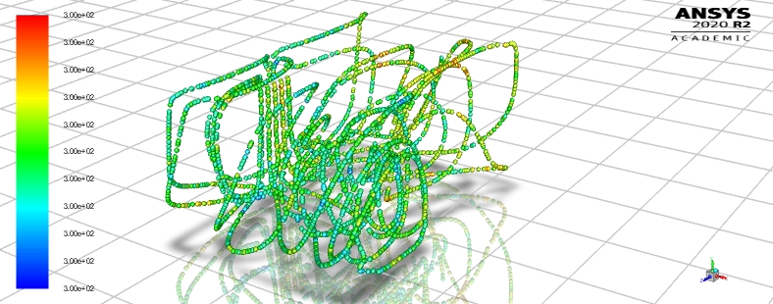
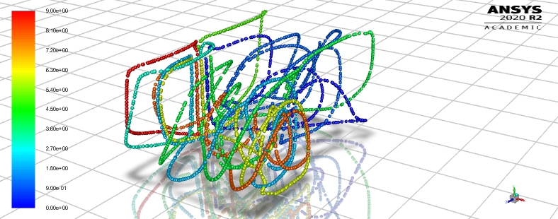
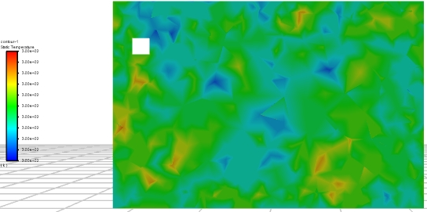
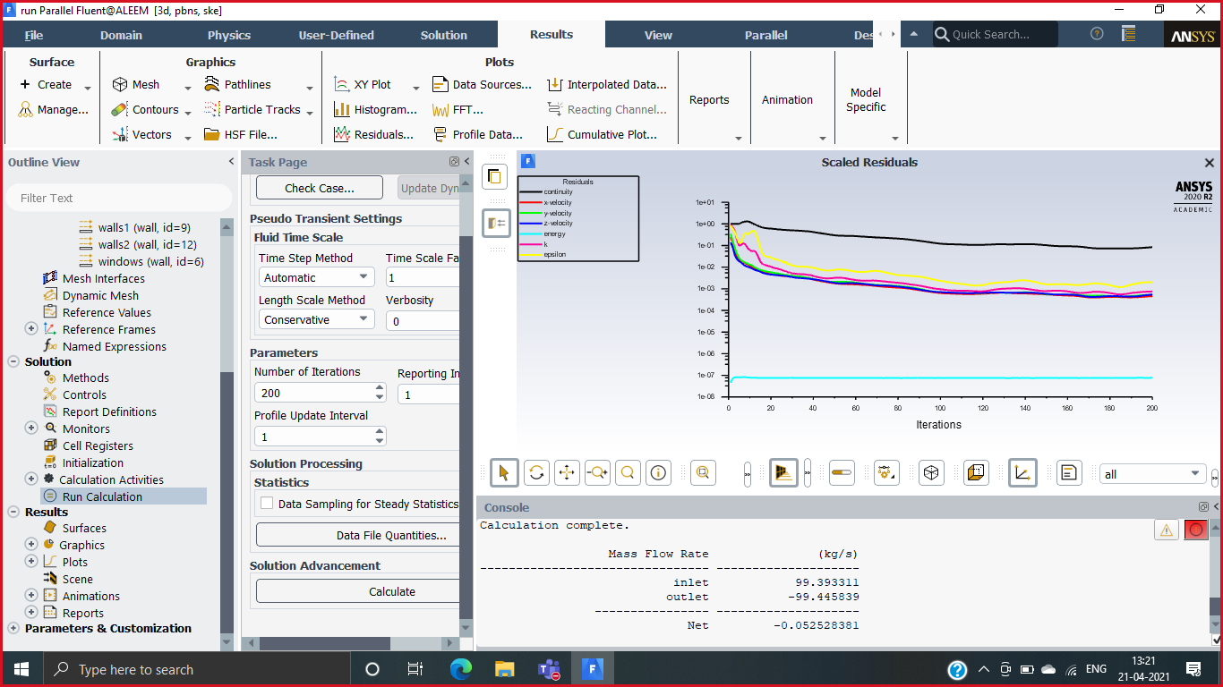
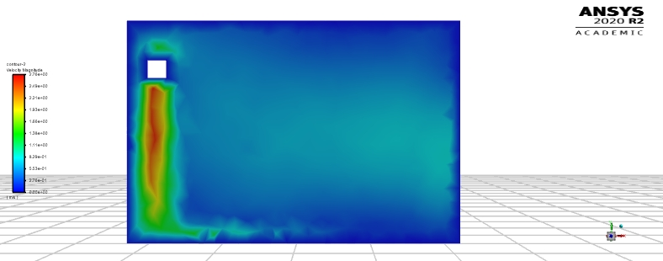
Fluid Mechanics
Project based Learning
Topic: AIR CONDITIONER IN A ROOM
Results
This model simulates the flow in a room.
Using ANSYS FLUENT, analyze the flow in a room with air conditioner The science which manages making a controlled in indoor space is alluded to as cooling. Prior days the cooling wind up regarded
as a luxurious, anyway in gift situation because of substitute in natural conditions the cooling framework has risen as an integral
part of human ways of life. In tropical and subtropical nations cooling by utilizing cooling is fundamental capacities of front-line
advancement. In this manner, it is important to create present day cooling framework to meet the necessities comfort conditions
TEMPERATURE CONTOUR
Introduction
PATHLINES
Objective
Results
Increased Fuel consumption now-a-days is a great concern for customers as well as for carmakers. To overcome this problem carmakers often try to improve the aerodynamics of the car so that fuel consumption can be minimized. Aerodynamics can be improved by making design changes to the car or adding some aerodynamics components like spoilers, roof rails or vortex generator to the car. Components like vortex generators and spoilers offers great drag resistance and reduce the lift of the car. They also increases the mileage of a car.
To increase fuel efficiency and performance to greater extent some design changes can be made to the existing designs of Spoilers and vortex generator.
Shapes can be modified to reduce the mass and to increase aerodynamics more effectively so that fuel consumption can decrease to a good extent even at higher speeds.
TEMPERATURE CONTOUR
*Check mesh.
*Display mesh.
*Use steady state pressure based solver.
*Make energy ON. Set viscous model. Use k-epsilon model.
*Set material properties. Use defaults.
*Define cell zone conditions.
*Define boundary conditions. Set inlet as Velocity-Inlet with Velocity
Magnitude of 3 m/s.Set Turbulence Specification Method to Intensity and
Viscosity Ratio with values of 1 and 5 resp. Set Temperature to 283K. Set outlet
zone type to Pressure-Outlet. Set Turbulence Specification Method to Intensity
and Viscosity Ratio with values of 1 and 5 resp. Set Temperature to 300K. For
zone walls1, set Convection Thermal Condition with HTC as 5
w/m2-k.
*Define operating conditions. Set Gravity as -9.81 m/s2 in Z direction.
Physics set up
Results
TEMPERATURE CONTOUR
VELOCITY CONTOUR
Numerical solution
Results
Dept. Of Mechanical Eng., Galgotias University
Team Member Instructor
1. SHAH ABDUL ALEEM Mr. Faisal Shameem
2 . SHOAIB AKHTAR ANSARI

